Slide 1
Starting Out With Junit 5
JavaOne Hands On Lab (HOL 1695)
Jeanne Boyarsky
October 2, 2017
slideshare.net/boyarsky
Twitter @jeanneboyarsky
Blog: http://www.selikoff.net

Slide 2
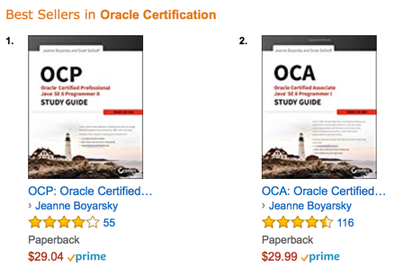
About Me
15 years as
Java Developer
JUnit user
@jeanneboyarsky

Slide 3
Why JUnit 5?
Java 8 support!
More annotations/assertions!
More power!

Slide 4






Supports
Not Yet
Note: Eclipse requires update to Oxygen until JUnit 5 released
Notes:
Image sources:
https://commons.wikimedia.org/wiki/File:Antu_netbeans-ide.svg
https://commons.wikimedia.org/wiki/File:Eclipse-SVG.svg
https://commons.wikimedia.org/wiki/File:IntelliJ_IDEA_Logo.svg
https://ant.apache.org
https://maven.apache.org

Slide 5
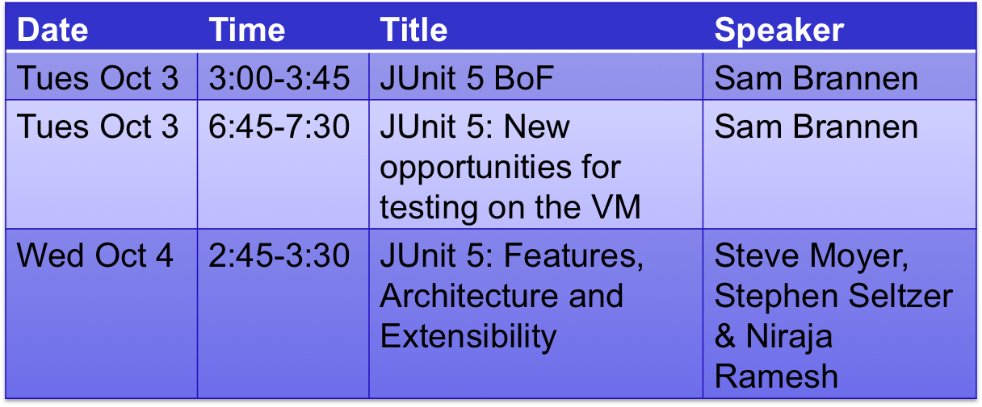
Upcoming JUnit Sessions

Slide 6
What you’ll learn in the lab
How to convert a Maven project
  New jars
  Required config
Changes from Junit 4
New functionality

Slide 7

Let’s start!
On to the
lab!
Notes:
https://pixabay.com/p-154544/?no_redirect

